Slide 1
Salesforce Programmatic Model 1

Slide 2
Agenda
Why to Code ?
Introduction to Apex Language
Architecture of language(How does apex works?)
Language constructs
Apex naming conventions
Data Types
Debugging

Slide 3
Why to Code ?
To create custom business logic, validations, and functionalities that go beyond the standard capabilities of Salesforce's point-and-click tools.
To provide more flexibility and develop Customized applications through custom logic
To meet Personalized requirements of client
To Communicate/collaborate with external systems / integrations
For handling Bulk data (more than 50,000 records)
To handle operations through asynchronous process
Complex business processes that are unsupported by configuration
To respond to events (such as record updates, inserts, deletes, undeletes) and perform custom actions or updates

Slide 4
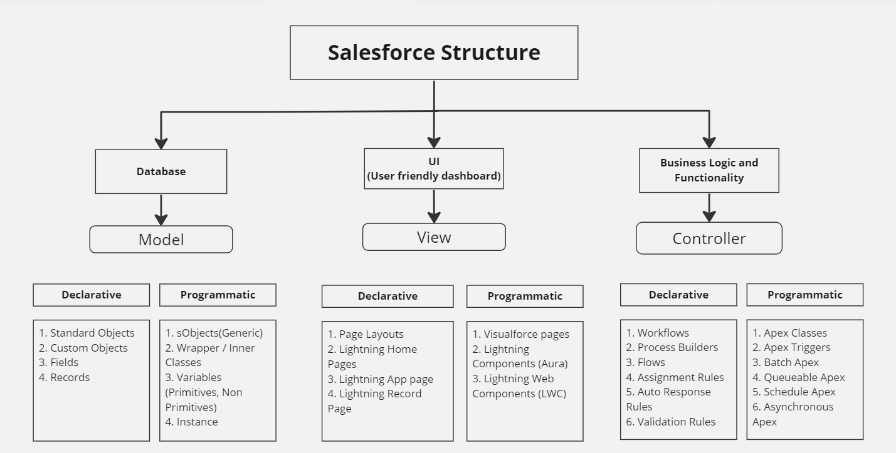
Introduction to Apex Language

Slide 5
Introduction to Apex Language
Apex is a strongly typed, object-oriented programming language that allows developers to execute flow and transaction control statements on Salesforce servers.
Apex is a development platform for building software as a service (SaaS) applications on top of Salesforce.com's customer relationship management (CRM) functionality.
Uses syntax that looks like Java and acts like database stored procedures.
Allows developers to add business logic.
Apex applications are usually hosted and run directly from Salesforce.com's servers.

Slide 6
Apex is :
Rigorous
Strongly-typed language that uses direct references to schema objects such as object and field names
Fails quickly at compile time if any references are invalid
Hosted
Apex is interpreted, executed, and controlled entirely by the Force.com platform.
Apex allows developers to create business logic, automation, and custom processes within the Salesforce ecosystem

Slide 7
Apex is:
Multitenant Aware : This allows multiple organizations to use the same infrastructure and resources while ensuring fair resource allocation, data isolation, security, and scalability.
Automatically Upgradeable
Easy to Test

Slide 8



How does Apex Works ?
Apex Compiler
Uncompiled Apex
Compiled Apex
Developer
Application Server
Developer friendly message
Metadata
Internet
Request
Apex Runtime
Apex Request
Apex Class
Result
End User
Compiled Apex
Notes:
Apex architecture

Slide 9
How does Apex Works ?
Source Code Creation
Saving the Code
Syntax and Semantic Analysis
Compilation and stored as metadata
End user sends request
End user receives the output
Governor Limits Check
Metadata
Notes:
Apex architecture

Slide 10
How to Invoke Apex?
On UI Events
For example: When user clicks on a button from UI, gives input
To Attach Business logic to an Application
On System Events
For example: After a specific time period, a process must run
On Database Events
For example: On creation, update or deletion of a record

Slide 11
Variables
Data Types
Expressions
Language Constructs
SOQL and SOSL
Exception
Loops
Statements

Slide 12
Blob
Data Types
Long
Integer
Decimal
Long
Primitive Data Types
Double
Id
String
Date
&
DateTime
Boolean

Slide 13
Blob Data Type
In Salesforce Apex, the Blob data type represents binary data, which can include a variety of binary content such as images, audio files, documents, and more. The term "Blob" stands for Binary Large Object. The Blob data type is used to store, manipulate, and process binary data within Apex code.
Binary Data: A Blob represents a sequence of binary bytes. It can hold any type of binary data, such as images, PDFs, ZIP files, and so on.
// Encoding a string to a Blob
String originalString = 'Hello, world!';
Blob encodedBlob = Blob.valueOf(originalString);

Slide 14
sObject s1 = new Account(Name = BFL); sObject s2 = new Contact(lastName = ‘Jacobs’);
sObject s3 = new Project__c(Name = 'Adidas');
SObject
Generic Object
SObject Data Types
Specific Object
Account accountObj = new Account(Name = BFL); Contact contactObj = new Contact(lastName = ‘Jacobs’);
Project__c projectObj = new Project__c(Name = 'Adidas');
Account, Contact, Project__c, etc

Slide 15
The "System class" refers to a set of predefined classes provided by the Salesforce platform.
These classes are part of the Salesforce runtime environment and offer a wide range of functionalities to interact with the platform, perform operations on data, manage security, and more.
Examples: System.debug, System.assert, System.Math etc.
SystemClass s = new SystemClass();
System Class
Objects created from Class
A "user-defined class" is a class that you create yourself to encapsulate custom logic, data, and behavior within your Apex code.
These classes are defined by developers to meet specific requirements or implement custom business processes.
User-defined classes can have properties, methods, constructors, and other members that you define.
They are used to organize code, improve code reusability, and implement custom business logic.
User Defined Class
MyClass m = new MyClass();

Slide 16
Collections
List/Array
For example: List<Account> accountList = new List<Account>();
Set
For example: Set<Id> accountIdSet = new Set<Id>();
Map
For example: Map<Id, Account> accountIdVSAccountMap = new Map<Id, Account>();

Slide 17
Variables
For example: Integer quantity;
Expressions For example: 1 + 1
Exceptions
For example: DML exception

Slide 18
Conditional (If-Else) Statements
For example:
if(condition) {
} else { }
Switch Statements
For example:
switch on expression {
when value1 { // when block 1
}
when value2 { // when block 2
}
}
Loops

Slide 19
For Loops
Traditional For Loops
List or Set Iteration for Loops
for (variable : list_or_set) { code_block }
for (init_stmt; exit_condition; increment_stmt) { code_block }
Integer[] myInts = new Integer[]{1, 2, 3, 4};
//List<Integer> myInts = new List<Integer>{1, 2, 3, 4};
for (Integer i : myInts) { System.debug(i); }
for (Integer i = 0, j = 0; i < 10; i++) { System.debug(i+1); }

Slide 20
Apex Class Syntax
private | public | global
[virtual | abstract | with sharing | without sharing | inherited sharing]
class ClassName
[implements InterfaceNameList]
[extends ClassName]
{
// The body of the class
}

Slide 21
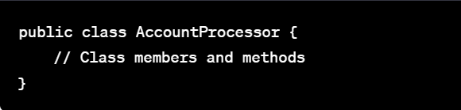
Apex Naming Conventions
Class Name and Helper Class:
Use PascalCase (capitalize the first letter of each word) for class names.
Choose descriptive and meaningful names that convey the purpose of the class.
<FunctionalEntity> & <ClassName>Helper
Ex: CalculatorProcessor, CalculatorProcessorHelper, ProjectController, ProjectControllerHelper

Slide 22
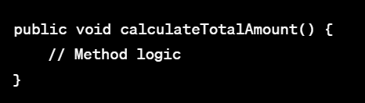
Apex Naming Conventions
Method/Function Names:
Use camelCase (capitalize the first letter of each word except the first) for method names.
Use descriptive names that indicate the purpose of the method.

Slide 23
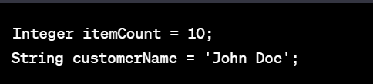
Apex Naming Conventions
Variable and Property Names:
Use camelCase for variable and property names.
Choose meaningful names that reflect the purpose of the variable or property.

Slide 24

Apex Naming Conventions
Constant Names:
Use uppercase letters with underscores for constants.
Constants are often declared as static final variables.
Trigger and Handler: <ObjectName>Trigger, <ObjectName>TriggerHandler.
Example : AccountTrigger, AccountTriggerHandler, CaseTrigger, CaseTriggerHelper

Slide 25
Apex Naming Conventions
UI (Page, Lighting Component etc.): Camel Case with first letter capital.
Other Development Components: Camel Case with first letter capital.
Collection Name: The collection variable name should always end with its type Map, List, Set
Ex. : contactList, idVsContactMap, accountIdVSContactsMap, accountIdSet.

Slide 26
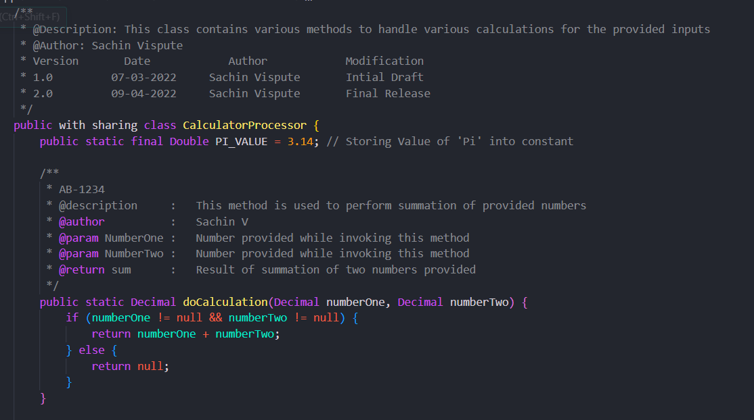

Slide 27
Debugging
Apex provides debugging support. You can debug your Apex code using the following:
Debug Logs
System.debug
Developer Console

Slide 28
Additional Resources
Apex Developer Guide
https://developer.salesforce.com/docs/atlas.en-us.apexcode.meta/apexcode/apex_dev_guide.htm
Trailhead
Blogs
Youtube

Slide 29
THANK YOU

